Slide 1
Refactoring
[Updated]

Slide 2
What is Refactoring?
Refactoring is the process of changing a software system such that
  the external behavior of the system does not change
    e.g., functional requirements are maintained
  but the internal structure of the system is improved
This is sometimes called
  “Improving the design after it has been written”
Refactoring formalizes good programming practices

Slide 3
Simple Examples
Consolidate duplicate conditional fragments
Before
if (isSpecialDeal()) {
total = price * 0.95;
send();
} else {
total = price * 0.98;
send();
}
After
if (isSpecialDeal()) {
total = price * 0.95;
} else {
total = price * 0.98;
}
send();

Slide 4
Simple Examples
Replace magic number with symbolic constant
Before
double potentialEnergy(double mass, double height){
return mass * 9.81 * height;
}
After
static final double GRAVITATIONAL_CONSTANT = 9.81;
double potentialEnergy(double mass, double height) {
return mass * GRAVITATIONAL_CONSTANT * height;
}

Slide 5
But, Refactoring is Dangerous!
Although refactoring helps to reduce bugs, it can also introduce new bugs into the code
Manager’s point of view
  if my programmers spend time “cleaning up the code” then that’s less time implementing required functionality (and my schedule is slipping as it is!)
To address these concerns
  refactoring needs to be systematic, incremental, and safe

Slide 6
Refactoring is Useful Too
The idea behind refactoring is to
  acknowledge that it will be challenging to get a design right the first time and, as a program’s requirements change, the design may need to change
  refactoring provides techniques for evolving the design in small incremental steps
Benefits
  often, code size is reduced after refactoring
  confusing structures are transformed into simpler structures
    which are easier to maintain and understand

Slide 7
A “Cookbook” can be Useful
Refactoring: Improving the Design of Existing Code
  by Martin Fowler (and Kent Beck, John Brant, William Opdyke, and Don Roberts)
Similar to the Gang of Four’s Design Patterns
  provides “refactoring patterns”
Also
  http://www.refactoring.com/catalog
  http://sourcemaking.com/refactoring

Slide 8
Principles in Refactoring
Fowler’s definition
Refactoring (noun)
  a change made to the internal structure of software to make it easier to understand and cheaper to modify without changing its observable behavior
Refactoring (verb)
  to restructure software by applying a series of refactoring without changing its observable behavior

Slide 9
Principles, continued
The purpose of refactoring is
  to make software easier to understand and modify
  no functionality is added, but the code is cleaned up, made easier to understand and modify, and sometimes is reduced in size
Contrast this with performance optimization
  functionality is not changed; only internal structure
  however, performance optimizations often involve making code harder to understand (but faster!)

Slide 10
Principles, continued
How do you make refactoring safe?
  First, use refactoring “patterns”
    Fowler assigns “names” to refactoring in the same way that the GoF’s book assigned names to patterns
  Second, test constantly!
    this ties into the agile design paradigm
    you write tests before you write the code
    after you refactor, you run the tests and check that they all pass
    if a test fails, the refactoring broke something, but you know about it right away and can fix the problem before you move on

Slide 11
Why Should you Refactor?
Refactoring improves the design of software
  without refactoring, a design will “decay” as people make changes to a software system
Refactoring makes software easier to understand
  because structure is improved, duplicated code is eliminated, etc.
Refactoring helps you find bugs
  Refactoring promotes a deep understanding of the code at hand, and this understanding aids the programmer in finding bugs and anticipating potential bugs
Refactoring helps you program faster
  because a good design enables progress

Slide 12
When Should you Refactor?
The Rule of Three
  Three “strikes” and you refactor
Refactor when you add functionality
  do it before you add the new function to make it easier to add the function
  or do it after to clean up the code after the function is added
Refactor when you need to fix a bug
Refactor as you do a code review

Slide 13
Problems with Refactoring
Databases
  Business applications are often tightly coupled to underlying databases
  code is easy to change; databases are not
Changing interfaces
  Some refactoring requires that interfaces be changed
  if you own all the calling code, no problem
  if not, the interface is “published” and can’t change

Slide 14
Refactoring: Where to Start?
How do you identify code that needs to be refactored?
Look for “Bad Smells” in code
  A chapter in Fowler’s book
  Several online sources
    http://sourcemaking.com/refactoring/bad-smells-in-code
They present examples of “bad smells” and then suggest refactoring techniques to apply
Tools such as Codegrip, Checkstyle, PMD, FindBugs, and SonarQube can automatically identify code smells

Slide 15
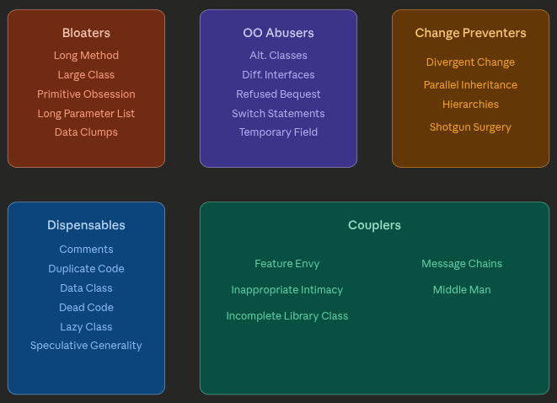
Code Smells

Slide 16
Bad Smells in Code
Duplicated code
  Bad because if you modify one instance of duplicated code but not the others, you (may) have introduced a bug!
Long method
  Long methods are more difficult to understand
  performance concerns with respect to short methods are largely obsolete
Large Class
  Large classes try to do too much, which reduces cohesion
Long Parameter List
  Hard to understand, can become inconsistent if the same parameter chain is being passed from method to method

Slide 17
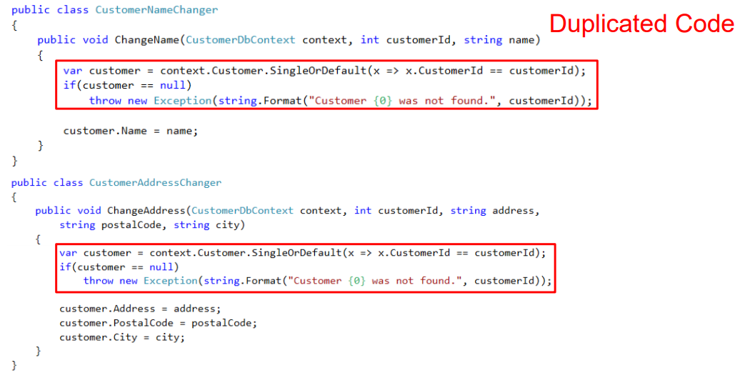
Duplicated Code

Slide 18
Long Method
class OrderService {
public void processOrder(Order order) {
// validate order
// Calculate total price
// apply discount
// format receipt
// print receipt
}
}

Slide 19
Long Parameter List
class PaymentService {
public void processPayment(String name, String email,
String cardNumber, String expiry,
double amount) {
// processing logic
}
}
Hard to remember parameter order
Easy to pass wrong values
Repeated across methods

Slide 20
Bad Smells in Code
Divergent Change
  Symptom: one type of change requires changing one subset of methods; another type of change requires changing another subset
  e.g., “I have to change these three methods every time I get a new database.”
  Related to cohesion
Shotgun Surgery
  a change requires lots of little changes in a lot of different classes

Slide 21
Divergent Change
public class Employee {
…
public void updatePersonalInfo(String newName, String newEmail) {
this.name = newName;
this.email = newEmail;
}
// changed when UI or report formats evolve
public String formatForReport() {
return String.format("Employee Report: %s (%s) - Salary: $%.2f", name, department, salary);
}
public void sendEmailNotification(String message) {
// In real code: integrate with email service using 'email' field
System.out.println("Sending to " + email + ": " + message);
}
// changed when tax laws or pay rules update
public double calculatePay() {
double basePay = salary + (hoursWorked * 50.0); // overtime
return basePay * (1 - taxRate);
}
}
So many reason to update this class!

Slide 22
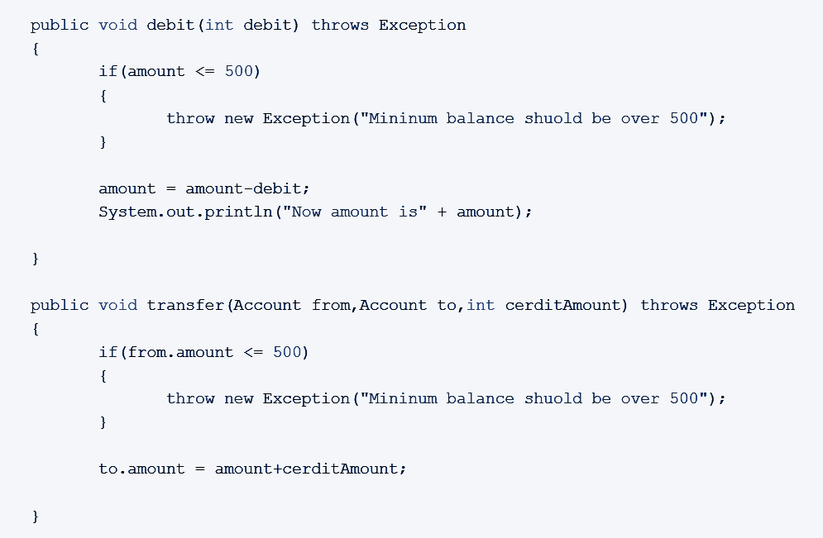
Shotgun Surgery
Change in business logic i.e., minimum amount or change in message wording fires change in multiple places

Slide 23
Bad Smells in Code
Feature Envy
  a method requires lots of information from some other class
  Move it closer!
Data Clumps
  attributes that clump together (are used together) but are not part of the same class

Slide 24
Feature Envy
// This class "envies" the data inside Customer
public class Invoice {
public double calculateDiscount(Customer customer) {
// Lots of access to Customer's data, very little to its own
if (customer.getTotalSpent() > 1000 && customer.getYearsAsMember() > 2) {
return customer.getTotalSpent() * 0.15;
} else if (customer.getTotalSpent() > 500) {
return customer.getTotalSpent() * 0.10;
}
return 0.0;
}
}
public class Customer {
private double totalSpent;
private int yearsAsMember;
// getters only (no behavior)
public double getTotalSpent() { return totalSpent; }
public int getYearsAsMember() { return yearsAsMember; }
}

Slide 25
Bad Smells in Code
Primitive Obsession
  characterized by a reluctance to use classes instead of primitive data types
Ex - using arrays for std_ID, std_name and std_marks instead of student class.
Switch Statements
  Switch statements are often duplicated in code; they can typically be replaced by the use of polymorphism (let OO do your selection for you!)

Slide 26
Bad Smells in Code
Lazy Class
  A class that no longer “pays its way”
  e.g., maybe a class that was downsized by a previous refactoring, or represented planned functionality that did not pan out
class Logger {
// Originally meant to do complex logging
// But now just prints a simple message
public void log(String message) {
System.out.println(message);
}
}
Logger is barely doing anything; could be replaced by System.out.println directly.
It adds extra complexity without benefit.

Slide 27
Bad Smells in Code
Message Chains
  a client asks an object for another object and then asks that object for another object etc.
  The client depends on the structure of the navigation
  any change to the intermediate relationships requires a change to the client
Middle Man
  If a class is delegating more than half its responsibilities to another class, do you really need it? Involves trade-offs; some design patterns encourage this (e.g., Decorator)
Inappropriate Intimacy
  Pairs of classes that know too much about each other’s implementation details (loss of encapsulation)

Slide 28
Message Chains
class Engine {
public int getHorsePower() { return 200; }
}
class Car {
private Engine engine = new Engine();
public Engine getEngine() { return engine; }
}
class Driver {
private Car car = new Car();
public void showHorsePower() {
// Train-wreck: driver reaches through Car to Engine
System.out.println("HP: " + car.getEngine().getHorsePower());
}
}
a client asks an object for another object and then asks that object for another object etc.
The client depends on the structure of the navigation
any change to the intermediate relationships requires a change to the client

Slide 29
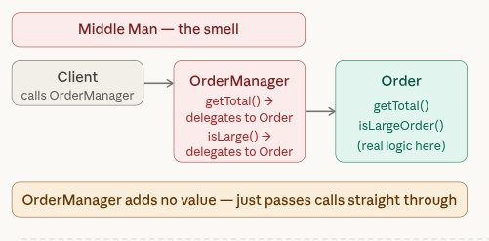
Middle Man
If a class is delegating more than half its responsibilities to another class, do you really need it?
Involves trade-offs; some design patterns encourage this (e.g., Decorator)

Slide 30
Inappropriate Intimacy
// BAD — Order exposes all its internals as public fields
class Order {
public List<Item> items = new ArrayList<>();
public double discountRate = 0.0;
public boolean isPaid = false;
public String customerEmail;
}
// OrderService reaches in and manipulates Order directly
class OrderService {
void addItem(Order order, Item item) {
order.items.add(item); // directly accessing
}
void applyDiscount(Order order) {
order.discountRate = 0.10; // setting internal state freely
}
void completePayment(Order order) {
order.isPaid = true; // changing internal flag directly
System.out.println("Confirmation sent to: " +order.customerEmail);
}
}
Pairs of classes that know too much about each other’s implementation details (loss of encapsulation)

Slide 31
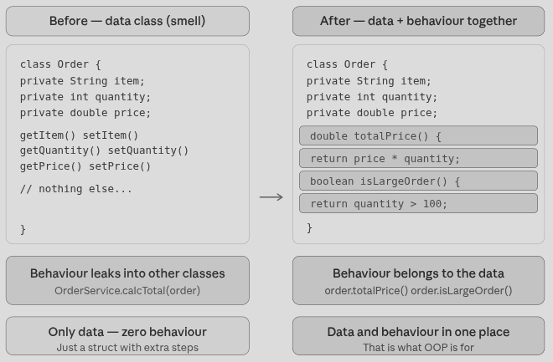
Bad Smells in Code
Data Class (information holder)
  These are classes that have fields, getting and setting methods for the fields, and nothing else; they are data holders, but objects should be about data and behavior

Slide 32
Bad Smells in Code
Data Class (information holder)
  These are classes that have fields, getting and setting methods for the fields, and nothing else; they are data holders, but objects should be about data and behavior
Not all data classes are bad.
They’re only a problem when they should have behavior but don’t or their behaviour is scattered

Slide 33
Bad Smells in Code
Comments
  Comments are sometimes used to hide bad code
  “…comments are often used as a deodorant”

Slide 34
Refused Bequest
interface Worker {
void work();
}
class HumanEmployee implements Worker {
public void work() {
System.out.println("Human working...");
}
public void applyForLeave() {
System.out.println("Applying for leave...");
}
}
class Robot implements Worker {
public void work() {
System.out.println("Robot working automatically...");
}
}
Refused Bequest
A subclass ignores most of the functionality provided by its superclass
Subclass may not pass the “IS-A” test
(If class Y is a type of class X, then Y IS-A X.
A Dog IS-A Animal
A Car IS-A Vehicle
A SavingsAccount IS-A Account
)

Slide 35
The Catalog of Refactoring Patterns
Large list of refactoring patterns (http://www.refactoring.com/catalog)
  Extract Method
  Extract Variable
  Extract Class
  Replace Temp with Query
  Move Method
  Replace Conditional with Polymorphism
  Introduce Null Object
  Separate Query for Modifier
  Introduce Parameter Object
  Encapsulate Collection
  Replace Nested Conditional with Guard Clauses

Slide 36
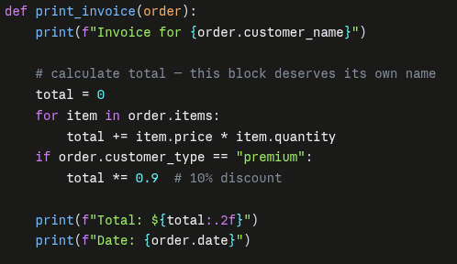
Extract Method
You have a code fragment that can be grouped together
Turn the fragment into a method whose name explains the purpose of the fragment

Slide 37
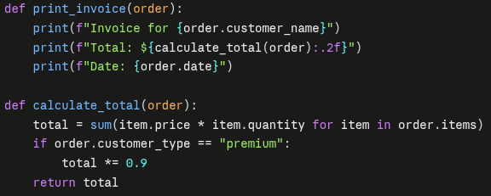
Extract Method

Slide 38
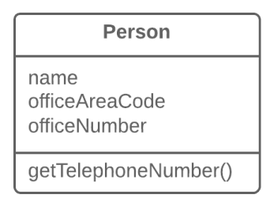
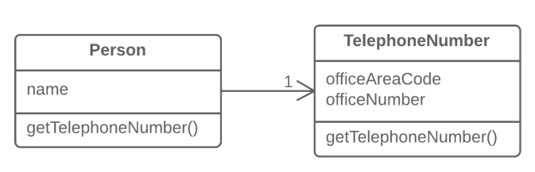
Extract Class
When one class does the work of two, awkwardness results
Instead, create a new class and place the fields and methods responsible for the relevant functionality in it

Slide 39
Extract Variable
You have an expression that’s hard to understand
Place the result of the expression or its parts in separate variables that are self-explanatory
class PriceCalculator {
public double calculatePrice(double quantity, double itemPrice) {
return quantity * itemPrice * (quantity > 100 ? 0.9 : 0.95);
}
}

Slide 40
Extract Variable
class PriceCalculator {
public double calculatePrice(double quantity, double itemPrice) {
double basePrice = quantity * itemPrice;
double discountRate = (quantity > 100) ? 0.9 : 0.95;
return basePrice * discountRate;
}
}
class PriceCalculator {
public double calculatePrice(double quantity, double itemPrice) {
double basePrice = quantity * itemPrice;
boolean isBulkOrder = quantity > 100;
double discountRate = isBulkOrder ? 0.9 : 0.95;
return basePrice * discountRate;
}
}
Even Better

Slide 41
Replace Temp with Query
You are using a temporary variable to hold the result of an expression
  Extract the expression into a method
  Replace all references to the temp with an expression
  The new method can then be used in other methods

Slide 42
Replace Temp with Query
class Order {
private int quantity;
private double itemPrice;
public double calculateTotal() {
double basePrice = quantity * itemPrice; // temp variable
if (basePrice > 1000) {
return basePrice * 0.95;
} else {
return basePrice * 0.98;
}
}
}
basePrice is a temporary variable
Logic is tied to this method only
Can’t reuse basePrice elsewhere

Slide 43
Replace Temp with Query
class Order {
private int quantity;
private double itemPrice;
public double calculateTotal() {
if (getBasePrice() > 1000) {
return getBasePrice() * 0.95;
} else {
return getBasePrice() * 0.98;
}
}
private double getBasePrice() {
return quantity * itemPrice;
}
}
class Order {
private int quantity;
private double itemPrice;
public double calculateTotal() {
double basePrice = quantity * itemPrice; // temp variable
if (basePrice > 1000) {
return basePrice * 0.95;
} else {
return basePrice * 0.98;
}
}
}

Slide 44
Move Method
A method is using more features (attributes and operations) of another class than the class on which it is defined
Create a new method with a similar body in the class it uses most. Either turn the old method into a simple delegation or remove it altogether

Slide 45
Move Method
class Engine {
private double distance;
private double fuelUsed;
public double getDistance() { return distance; }
public double getFuelUsed() { return fuelUsed; }
public double calculateFuelEfficiency() {
return distance / fuelUsed;
}
}
class Car {
Engine engine;
// Optional delegation
public double calculateFuelEfficiency() {
return engine.calculateFuelEfficiency();
}
}
class Engine {
private double distance;
private double fuelUsed;
public double getDistance() { return distance; }
public double getFuelUsed() { return fuelUsed; }
}
class Car {
Engine engine;
public double calculateFuelEfficiency() {
// Mostly using Engine data
return engine.getDistance() /engine.getFuelUsed();
}
}

Slide 46
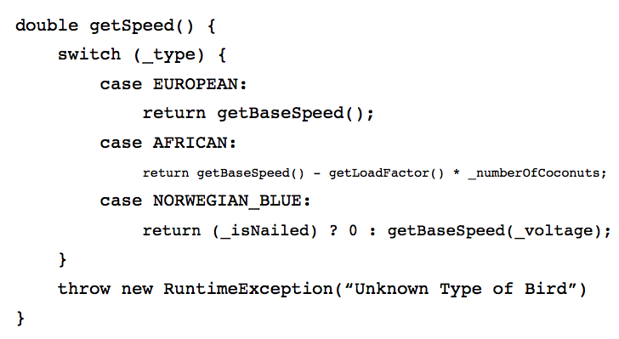
Replace Conditional with Polymorphism
You have a conditional that chooses different behavior depending on the type of an object
Move each “leg” of the conditional to an overriding method in a subclass. Make the original method abstract.

Slide 47
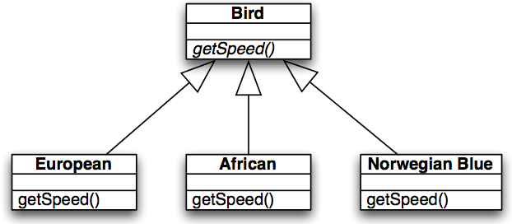
Replace Conditional with Polymorphism
void printSpeed(Bird[] birds) {
for (int i=0; i<birds.length; i++) {
System.out.println(“” + birds[i].getSpeed());
}
}

Slide 48
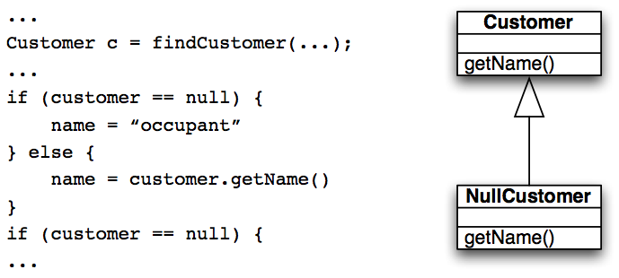
Introduce Null Object
Repeated checks for a null value
Rather than returning a null value from findCustomer() return an instance of a “null customer” object

Slide 49
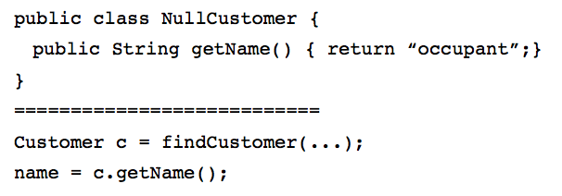
Introduce Null Object
The conditional goes away entirely!

Slide 50
Separate Query for Modifier
class Invoice {
private boolean readyForSummaries = false;
private double totalOutstanding;
public double getTotalOutstandingAndSetReadyForSummaries() {
// calculate total
totalOutstanding = 500.0;
// side effect (modifying state)
readyForSummaries = true;
return totalOutstanding;
}
}
getTotalOutstandingAndSetReadyForSummaries()
It is a query method, but it is also changing the state of the object being called
This change is known as a “side effect” because it’s not the primary purpose of the method

Slide 51
Separate Query for Modifier
class Invoice {
private boolean readyForSummaries = false;
private double totalOutstanding;
// Pure query (no side effects)
public double getTotalOutstanding() {
totalOutstanding = 500.0;
return totalOutstanding;
}
// Explicit modifier
public void setReadyForSummaries() {
readyForSummaries = true;
}
}
It is generally accepted practice that queries should not have side effects so this refactoring says to split methods into query and modification.
Try as best as possible to avoid any side effects in query methods

Slide 52
Introduce Parameter Object
You have a group of parameters that go naturally together
  Stick them in an object and pass the object
The new class starts out as a data holder but will likely attract methods to it
class InvoiceService {
public double amountInvoicedIn(Date start, Date end) {
// logic using start and end
return 1000.0;
}
public double amountOverdueIn(Date start, Date end) {
// logic using start and end
return 200.0;
}
}
Primitive obsession too!

Slide 53
class DateRange {
private Date start;
private Date end;
public DateRange(Date start, Date end) {
this.start = start;
this.end = end;
}
public Date getStart() { return start; }
public Date getEnd() { return end; }
// behavior can grow here later
public boolean includes(Date date) {
return !date.before(start) && !date.after(end);
}
}
class InvoiceService {
public double amountInvoicedIn(DateRange range) {
// logic using range.getStart(), range.getEnd()
return 1000.0;
}
public double amountOverdueIn(DateRange range) {
// logic using range.getStart(), range.getEnd()
return 200.0;
}
}

Slide 54
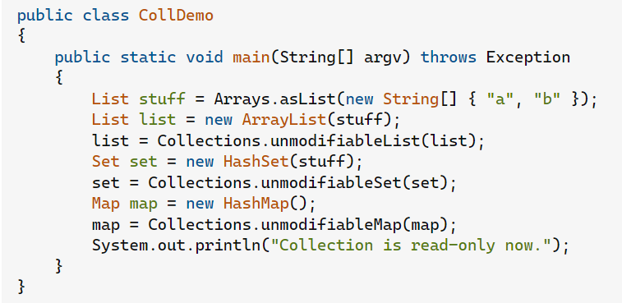
Encapsulate Collection
A method returns a collection
Make it return a read-only version of the collection and provide add/remove methods
Student class with
  Map getCourses();
  void setCourses(Map courses);
Change to
  ReadOnlyList getCourses();
  addCourse(Course c);
  removeCourse(Course c);

Slide 55
Replace Nested Conditional with Guard Clauses
This refactoring relates to the purpose of conditional code
  One type of conditional checks for a variation in “normal” behavior
  The system will do either A or B; both are considered “normal” behavior
  The other type of conditional checks for unusual circumstances that require special behavior; if all of these checks fail then the system proceeds with “normal behavior”
We want to apply this refactoring when we encounter the latter type of conditional
This refactoring is described in Fowler’s book as:
  “A method has conditional behavior that does not make clear the normal path of execution; Use guard clauses for all special cases”

Slide 56
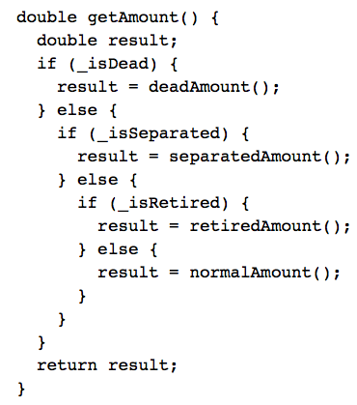
Replace Nested Conditional with Guard Clauses
This type of code may be the result of a novice programmer or due to a programming constraint imposed by some companies that a method can only have a single return
Often, this constraint causes more confusion than it is worth

Slide 57
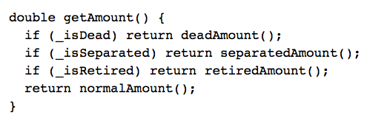
Replace Nested Conditional with Guard Clauses

Slide 58
Replace Nested Conditional with Guard Clauses
With this refactoring, all of the code trying to identify special conditions are turned into one-line statements that determine whether the condition applies and if so handles it
That’s why these statements are called “guard clauses”
Even though this method has four returns, it is easier to understand than the method before the refactoring

Slide 59
Wrapping Up
Refactoring is a useful technique for making non-functional changes to a software system that result in
  better code structures
  less code
  Many refactorings are triggered via the discovery of duplicated code
  The refactorings then show you how to eliminate duplication
Bad Smells
  Useful analogy for discovering places in a system “ripe” for refactoring

Slide 60
Acknowledgments
Dr. Emily Navarro, University of California, Irvine
Professor Kenneth M. Anderson, University of Colorado at Boulder

